Slide 1

SESSION-1:
AWS FUNDAMENTALS

Slide 2
Important Links
AWS Website —> https://aws.amazon.com
AWS Documentation —> https://docs.aws.amazon.com
AWS Management Console —> https://aws.amazon.com/console/
AWS Command Line Interface Download —> https://aws.amazon.com/cli/
AWS Certification —> https://aws.amazon.com/certification/

Slide 3

Amazon Web Services (AWS)
Global Data Centers and more than 200 services
Pay as you go
Built for business needs
Secure and robust

Slide 4
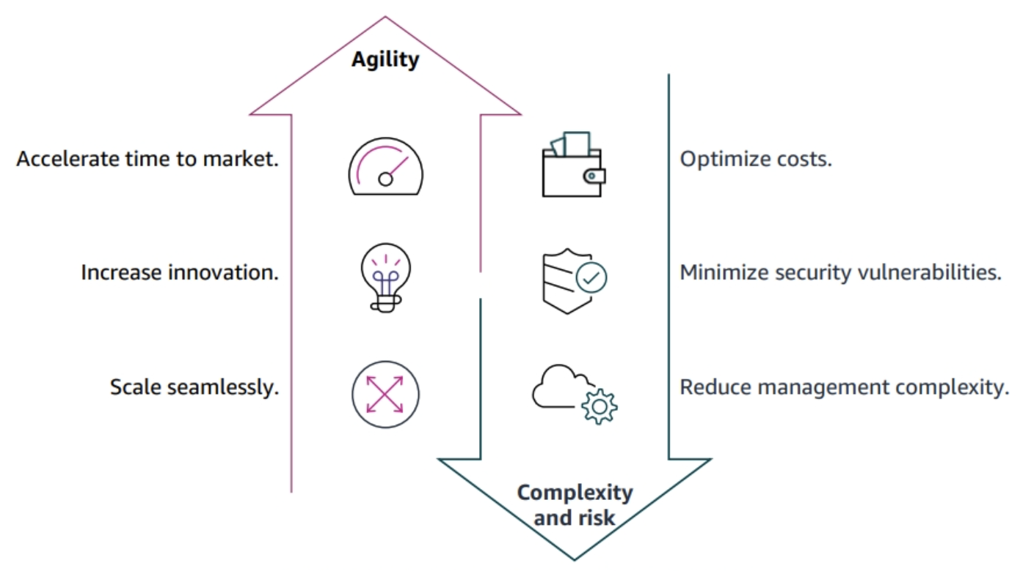
Why AWS?

Slide 5
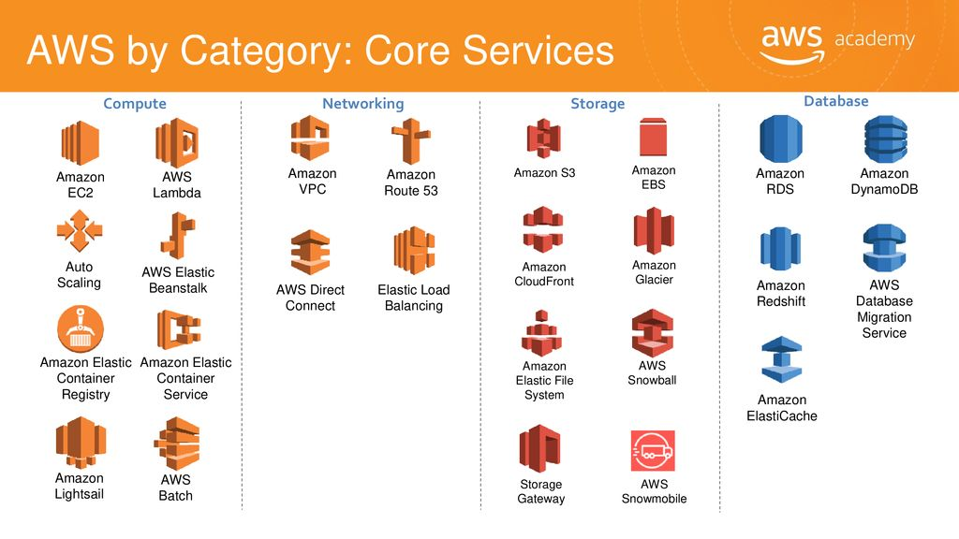

Slide 6
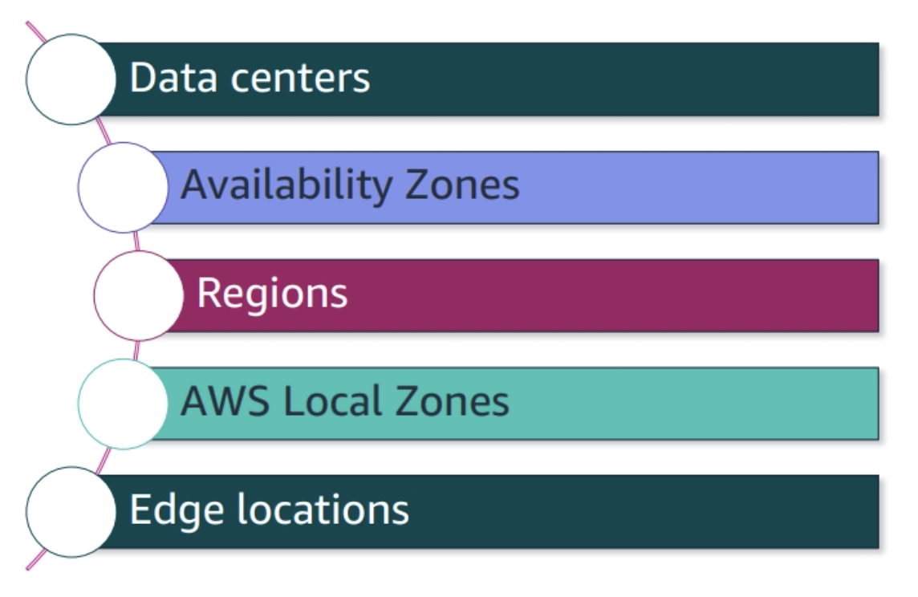
AWS Infrastructure

Slide 7

AWS Data Centers
AWS Services operate within AWS Data Centers which consist of thousands of servers.
Each location uses AWS proprietary network equipment.
Data Centers are organized into Availability Zones.

Slide 8
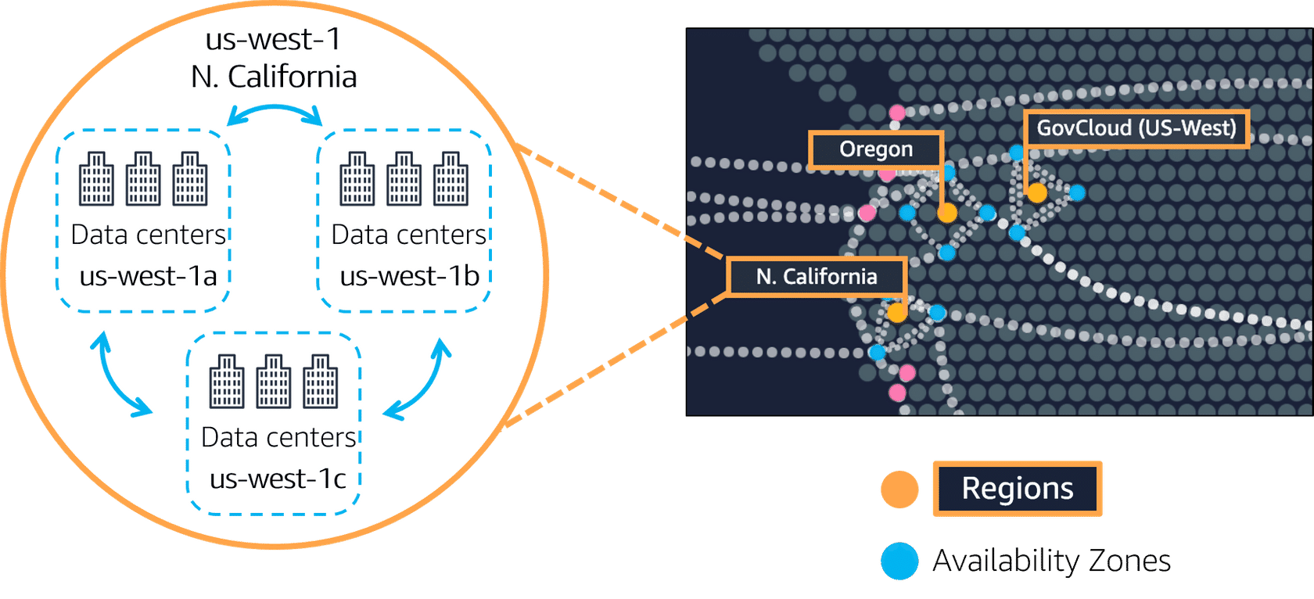
Availability Zones
Data centers in a Region which interconnected by high-speed private links.
Designed for fault toleration.
Using to achieve high availability.

Slide 9
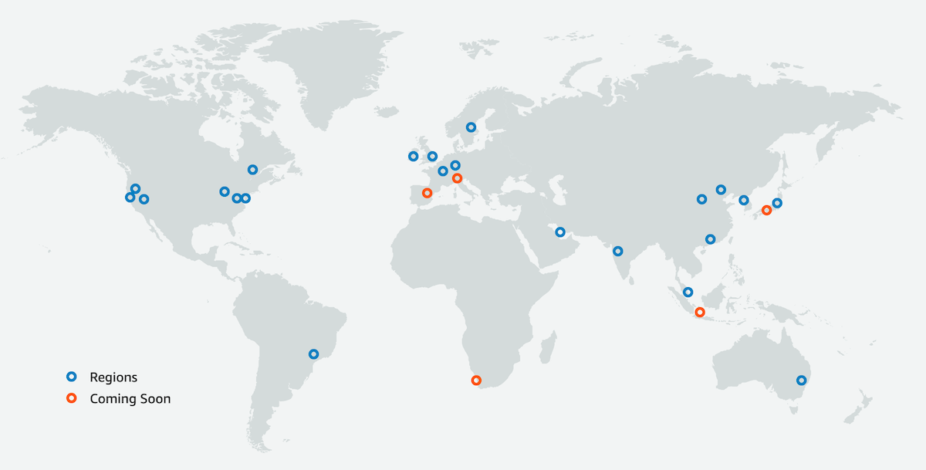
Regions
They are completely independent from each other.
They use AWS network infrastructure.
They have multiple Availability Zones.

Slide 10
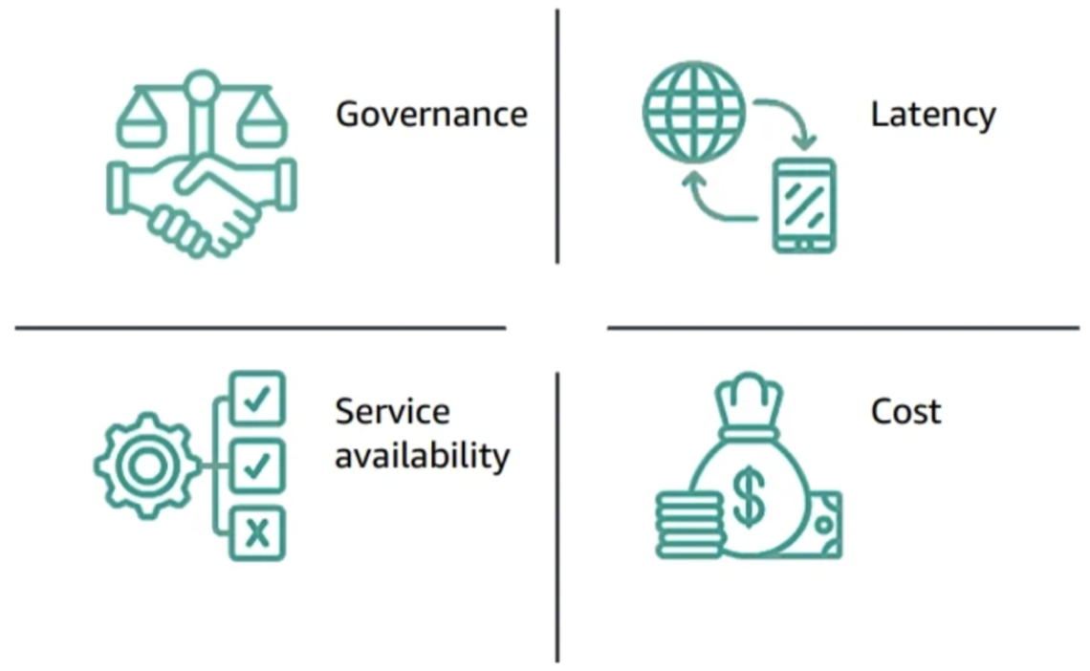
Region Selection Factors

Slide 11
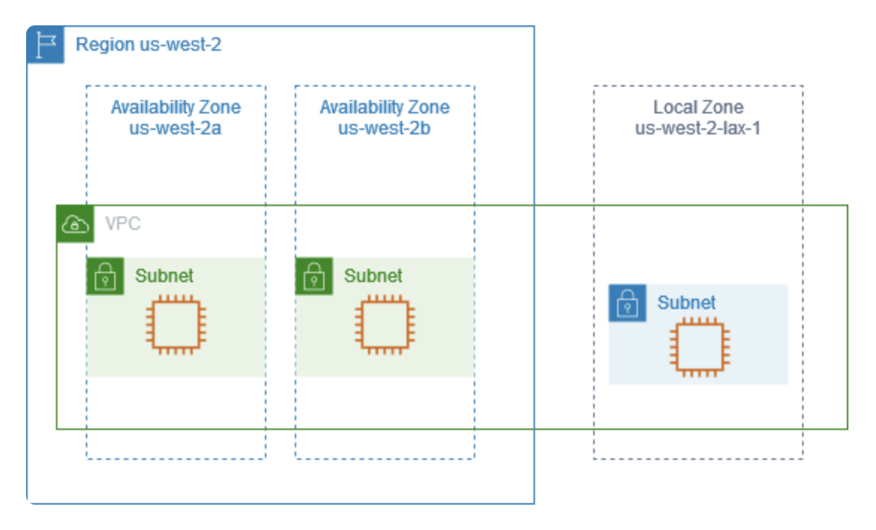
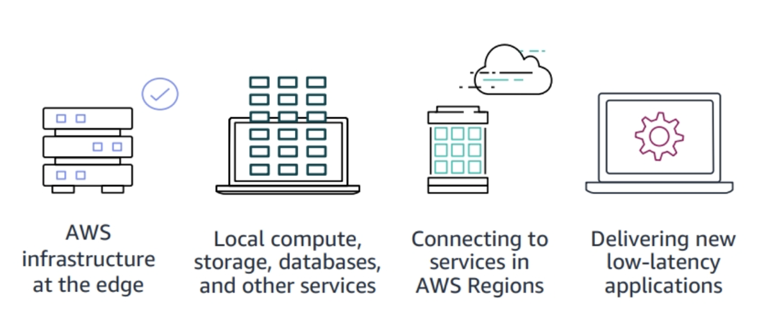
Local Zones
Use cases: Media and entertainment content creation, real-time gaming, machine learning inference, live video streaming, augmented virtuality (AR) and virtual reality (VR)

Slide 12
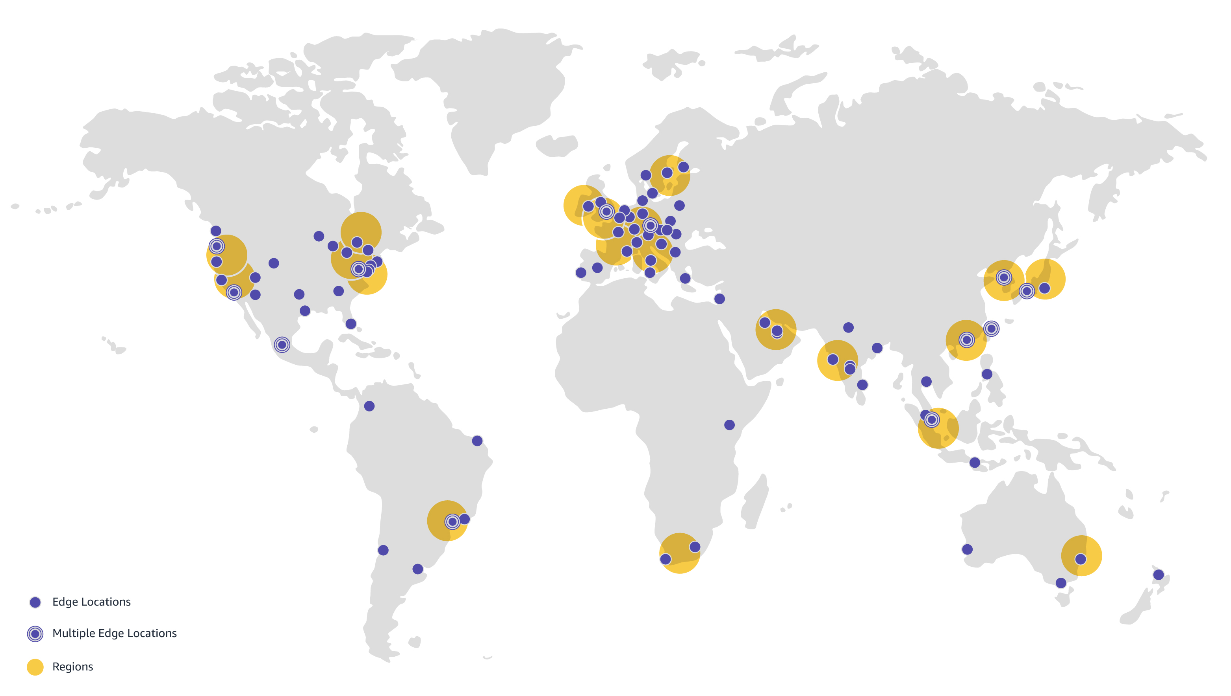
Edge Locations
Supports AWS Services such as Amazon Route 53 and Amazon Cloudfront.

Slide 13
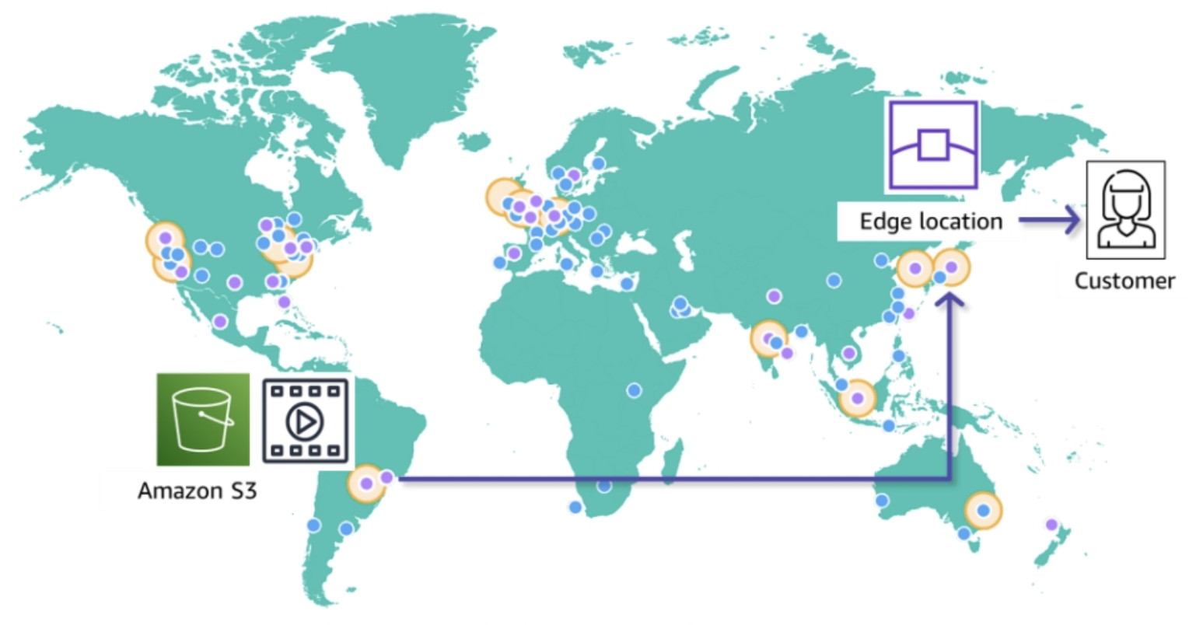
Edge Locations - Example

Slide 14
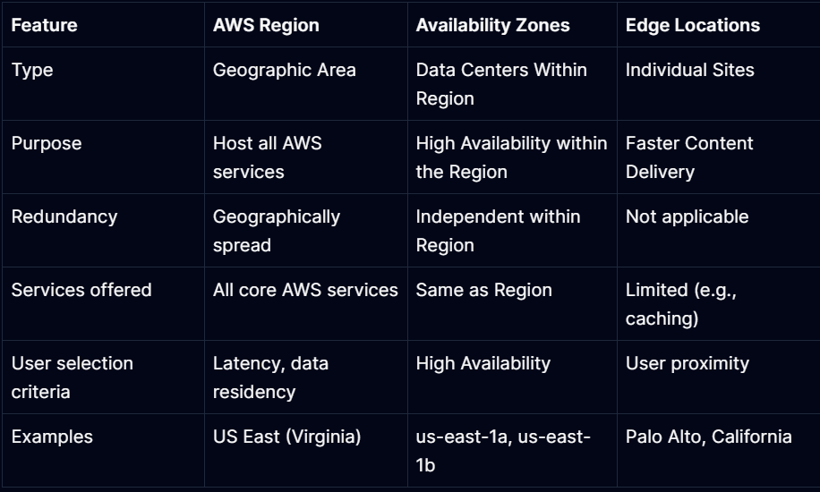
Summary

Slide 15

AWS Core Services - Simple Storage Service (S3)
It is a durable object storage solution.
Reduce Cost
Increase Agility
Accelerate Innovation
Strengthen Security
Cost factors: Storage Type, Replication, Versioning, Data Transfer, Requests and Retrievals, Management and Analytics

Slide 16
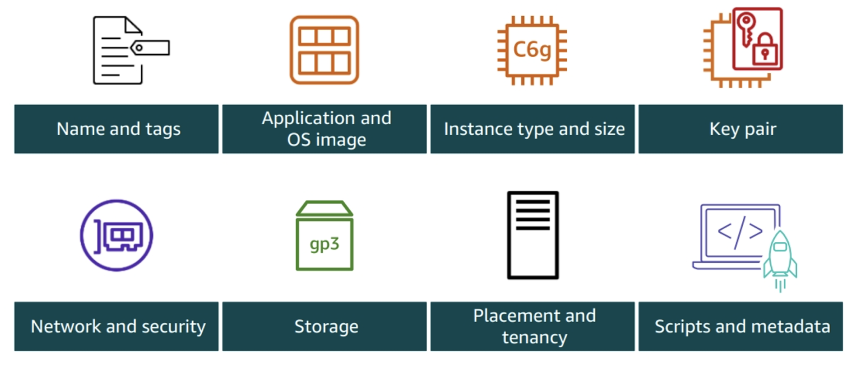

AWS Core Services - Elastic Compute Cloud (EC2)
Physical servers host EC2 instances in AWS Regions.
EC2 instances give secure and resizable compute capacity in the cloud.
The number of EC2 instances can be changed based on demand.

Slide 17
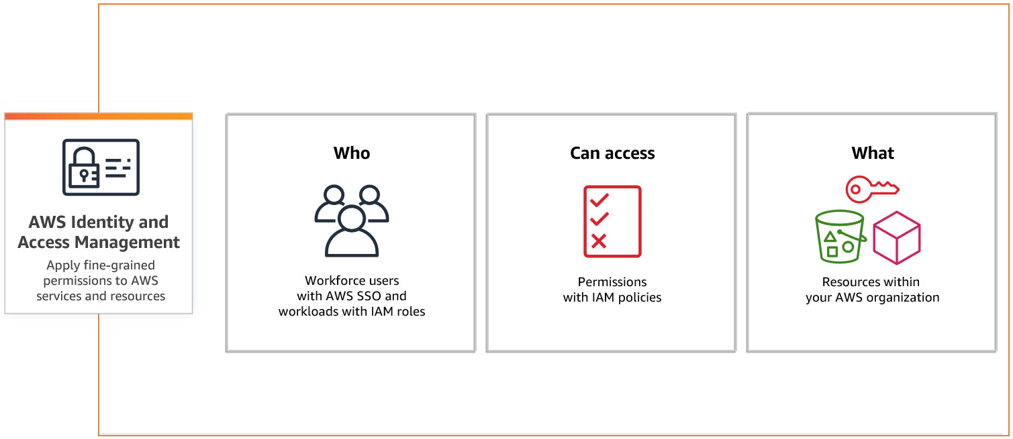
AWS Core Services - Identity and Access Management (IAM)
Create and manage users, groups and roles.
Manage access to AWS resources and services.

Slide 18
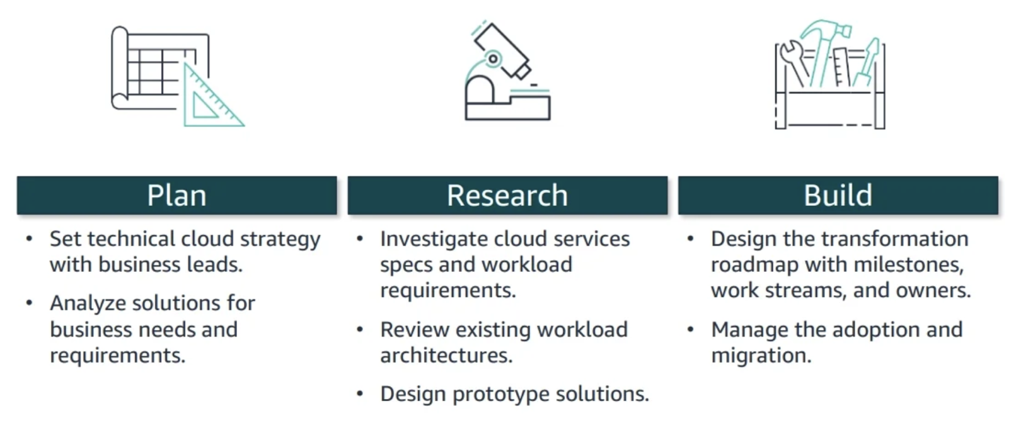
AWS Architecting Steps

Slide 19
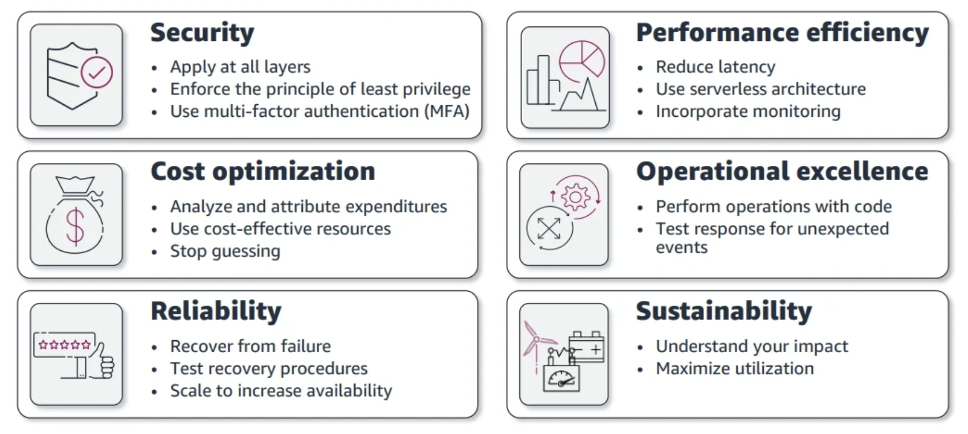
AWS Pillars

Slide 20
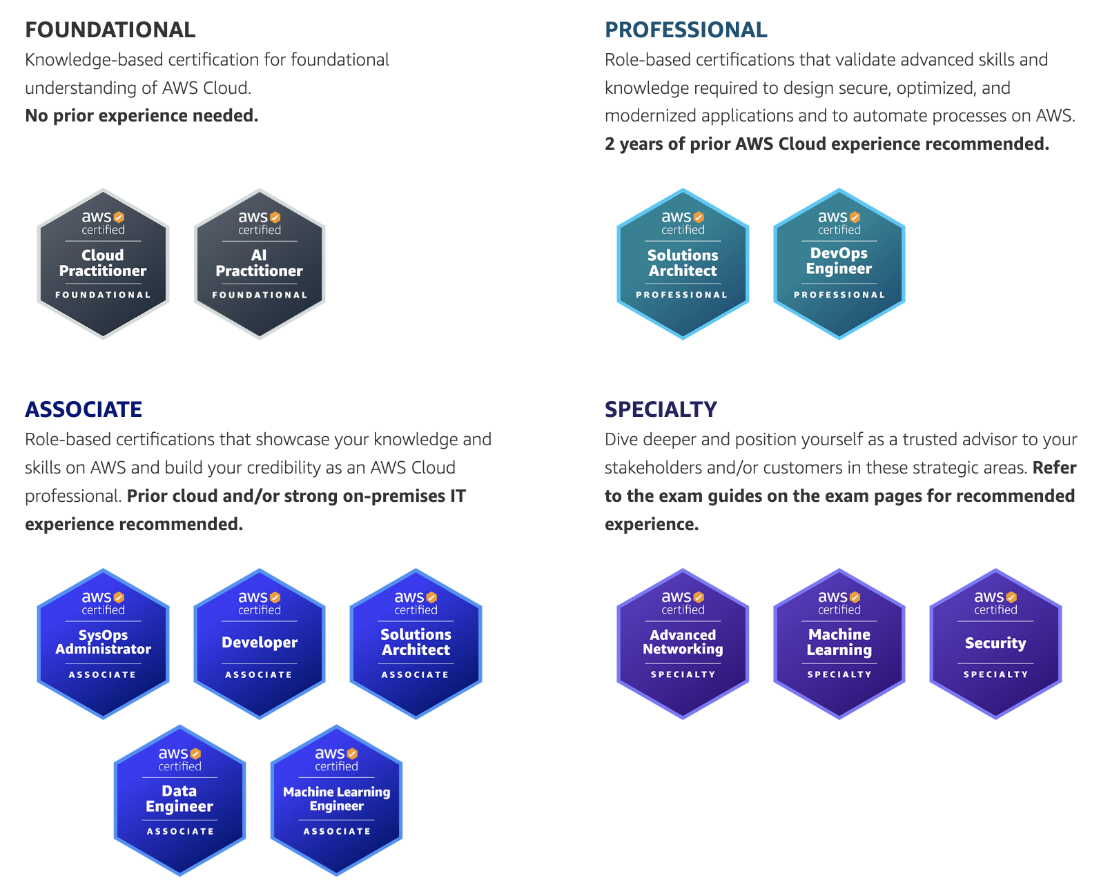
AWS Certifications

Slide 21
THANKS FOR LISTENING

